Slide 1
2D TRANSFORMATIONS

Slide 2
2D Transformations
What is transformations?
  The geometrical changes of an object from a current state to modified state.
Why the transformations is needed?
  To manipulate the initially created object and to display the modified object without having to redraw it.

Slide 3
2D Transformations
2 ways
  Object Transformation
    Alter the coordinates descriptions an object
    Translation, rotation, scaling etc.
    Coordinate system unchanged
  Coordinate transformation
    Produce a different coordinate system

Slide 4
Matrix Math
Why do we use matrix?
  More convenient organization of data.
  More efficient processing
  Enable the combination of various concatenations
Matrix addition and subtraction
a
c
a ± c
=
b ± d
b
±
d

Slide 5
Matrix Math
  How about it?
Matrix Multiplication
  Dot product
a
±
c d
e f
b
a b
c d
.
e f
g h
a.e + b.g a.f + b.h
c.e + d.g c.f + d.h
=

Slide 6
Matrix Math
What about this?
Type of matrix
.
1 2
3 1
1 2
=
6 6
2
3
.
1 2
3 1
=
a b
a
b
Row-vector
Column-vector

Slide 7
Matrix Math
Is there a difference between possible representations?
⎡
a
b
⎤
⎡
e
⎤
⎡
+
⎤
ae
bf
⎢
⎥
•
⎢
⎥
=
⎢
⎥
⎣
c
d
⎦
⎣
f
⎦
ce
+
df
⎣
⎦
[
]
⎡
a
b
⎤
[
]
e
f
•
⎢
⎥
=
ae
+
cf
be
+
df
⎣
c
d
⎦
[
]
⎡
a
c
⎤
[
]
e
f
•
⎢
⎥
=
ae
+
bf
ce
+
df
⎣
b
d
⎦

Slide 8
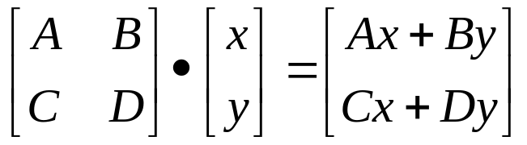
Matrix Math
We’ll use the column-vector representation for a point.
Which implies that we use pre-multiplication of the transformation – it appears before the point to be transformed in the equation.
What if we needed to switch to the other convention?

Slide 9
Translation
A translation moves all points in an object along the same straight-line path to new positions.
The path is represented by a vector, called the translation or shift vector.
We can write the components:
p'_{x} = p_{x} + t_{x}
p'_{y} = p_{y} + t_{y}
or in matrix form:
P' = P + T
?
=4
t_{y}
t_{x}
= 6
(2, 2)
x’
y’
x
y
t_{x}
t_{y}
= +

Slide 10
Rotation
A rotation repositions all points in an object along a circular path in the plane centered at the pivot point.
First, we’ll assume the pivot is at the origin.
P’
θ
P

Slide 11
Rotation
Review Trigonometry
=> cos φ = x/r , sin φ= y/r
  x = r. cos φ, y = r.sin φ
P’(x’, y’)
  => cos (φ+ θ) = x’/r
  x’ = r. cos (φ+ θ)
  x’ = r.cosφcosθ -r.sinφsinθ
  x’ = x.cos θ – y.sin θ
  =>sin (φ+ θ) = y’/r
  y’ = r. sin (φ+ θ)
  y’ = r.cosφsinθ + r.sinφcosθ
  y’ = x.sin θ + y.cos θ
θ
r
y’
P(x,y)
θ
r
y
φ
x’
x
Identity of Trigonometry

Slide 12
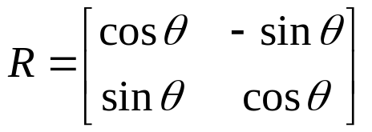
Rotation
We can write the components:
p'_{x} = p_{x} cos θ – p_{y} sin θ
p'_{y} = p_{x} sin θ + p_{y} cos θ
or in matrix form:
P' = R • P
θ can be clockwise (-ve) or counterclockwise (+ve as our example).
Rotation matrix
P’(x’, y’)
θ
y’
P(x,y)
θ
r
y
φ
x’
x

Slide 13
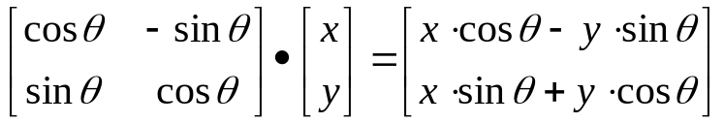
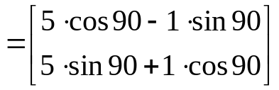
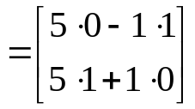
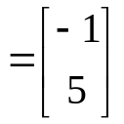
Rotation
Example
  Find the transformed point, P’, caused by rotating P= (5, 1) about the origin through an angle of 90°.

Slide 14
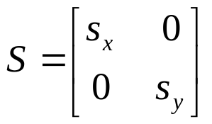
Scaling
Scaling changes the size of an object and involves two scale factors, S_{x} and S_{y} for the x- and y- coordinates respectively.
Scales are about the origin.
We can write the components:
p'_{x} = s_{x} • p_{x}
p'_{y} = s_{y} • p_{y}
or in matrix form:
P' = S • P
Scale matrix as:
P’
P

Slide 15
Scaling
If the scale factors are in between 0 and 1 ➔ the points will be moved closer to the origin ➔ the object will be smaller.
Example :
  P(2, 5), Sx = 0.5, Sy = 0.5
  Find P’ ?
P(2, 5)
P’

Slide 16
Scaling
If the scale factors are in between 0 and 1 ➔ the points will be moved closer to the origin ➔ the object will be smaller.
P’
Example :
  P(2, 5), Sx = 0.5, Sy = 0.5
  Find P’ ?
P(2, 5)
If the scale factors are larger than 1 ➔ the points will be moved away from the origin ➔ the object will be larger.
P’
Example :
  P(2, 5), Sx = 2, Sy = 2
  Find P’ ?

Slide 17
Scaling
If the scale factors are the same, S_{x} = S_{y} ➔ uniform scaling
Only change in size (as previous example)
P’
If S_{x} ≠ S_{y} ➔ differential scaling.
Change in size and shape
Example : square → rectangle
  P(1, 3), S_{x} = 2, S_{y} = 5 , P’ ?
P(1, 2)

Slide 18
Homogenous Coordinates
y
y
w
x
➔
x
Let’s move our problem into 3D.
Let point (x, y) in 2D be represented by point (x, y, 1) in the new space.
Scaling our new point by any value a puts us somewhere along a particular line: (ax, ay, a).
A point in 2D can be represented in many ways in the new space.
(2, 4) ----------→ (8, 16, 4) or (6, 12, 3) or (2, 4, 1) or etc.

Slide 19
Homogenous Coordinates
We can always map back to the original 2D point by dividing by the last coordinate
(15, 6, 3) ---→ (5, 2).
(60, 40, 10) -→ ?.
The fact that all the points along each line can be mapped back to the same point in 2D gives this coordinate system its name – homogeneous coordinates.

Slide 20
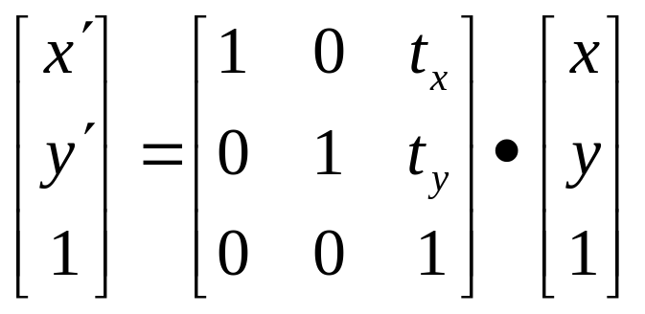
Matrix Representation
Point in column-vector:
Our point now has three coordinates. So our matrix is needs to be 3x3.
Translation
x
y
1

Slide 21
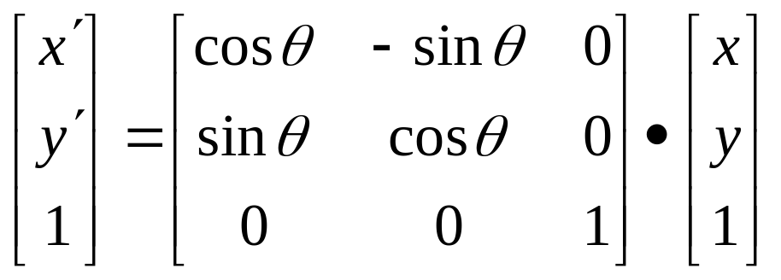
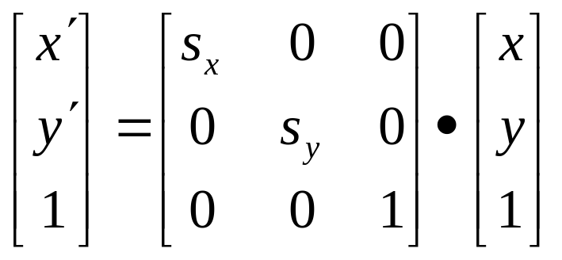
Matrix Representation
Rotation
Scaling

Slide 22
Composite Transformation
We can represent any sequence of transformations as a single matrix.
  No special cases when transforming a point – matrix • vector.
  Composite transformations – matrix • matrix.
Composite transformations:
  Rotate about an arbitrary point – translate, rotate, translate
  Scale about an arbitrary point – translate, scale, translate
  Change coordinate systems – translate, rotate, scale

Slide 23
Order of operations
So, it does matter. Let’s look at an example:
Translate
Rotate
Rotate
Translate

Slide 24
Composite Transformation Matrix
Arrange the transformation matrices in order from right to left.
General Pivot- Point Rotation
  Operation :-
    Translate (pivot point is moved to origin)
    Rotate about origin
    Translate (pivot point is returned to original position)
T(pivot) • R(θ) • T(–pivot)
1 0 t_{x}
0 1 t_{y}
0 0 1
cosθ -sinθ 0
sinθ cosθ 0
0 0 1
1 0 -t_{x}
0 1 -t_{y}
0 0 1
.
.
1 0 t_{x}
0 1 t_{y}
0 0 1
cosθ -sinθ -t_{x} cosθ+ t_{y} sinθ
sinθ cosθ -t_{x} sinθ - t_{y} cosθ
0 0 1
.
cosθ -sinθ -t_{x} cosθ+ t_{y} sinθ + t_{x}
sinθ cosθ -t_{x} sinθ - t_{y} cosθ + t_{y}
0 0 1

Slide 25
Composite Transformation Matrix
General Fixed-Point Scaling
Operation :-
    Translate (fixed point is moved to origin)
    Scale with respect to origin
    Translate (fixed point is returned to original position)
T(fixed) • S(scale) • T(–fixed)
Find the matrix that represents scaling of an object with respect to any fixed point?
Given P(6, 8) , Sx = 2, Sy = 3 and fixed point (2, 2). Use that matrix to find P’?

Slide 26
Answer
1 0 t_{x}
0 1 t_{y}
0 0 1
Sx 0 0
0 Sy 0
0 0 1
1 0 -t_{x}
0 1 -t_{y}
0 0 1
.
.
Sx 0 -t_{x} Sx
0 Sy -t_{y} Sy
0 0 1
1 0 t_{x}
0 1 t_{y}
0 0 1
Sx 0 -t_{x} Sx + t_{x}
0 Sy -t_{y} Sy + t_{y}
0 0 1
.
=
x =6, y = 8, Sx = 2, Sy = 3, t_{x} =2, t_{y} = 2
2 0 -2( 2) + 2
0 3 -2(3) + 2
0 0 1
6
8
1
10 20 1
.
=

Slide 27
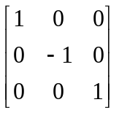
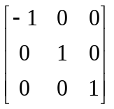
Other transformations
Reflection:
x-axis y-axis

Slide 28
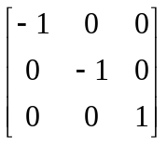
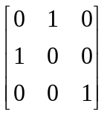
Other transformations
Reflection:
origin line x=y

Slide 29
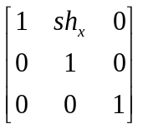
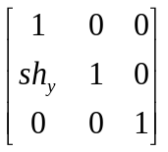
Other transformations
Shear:
x-direction y-direction

